Slide 1
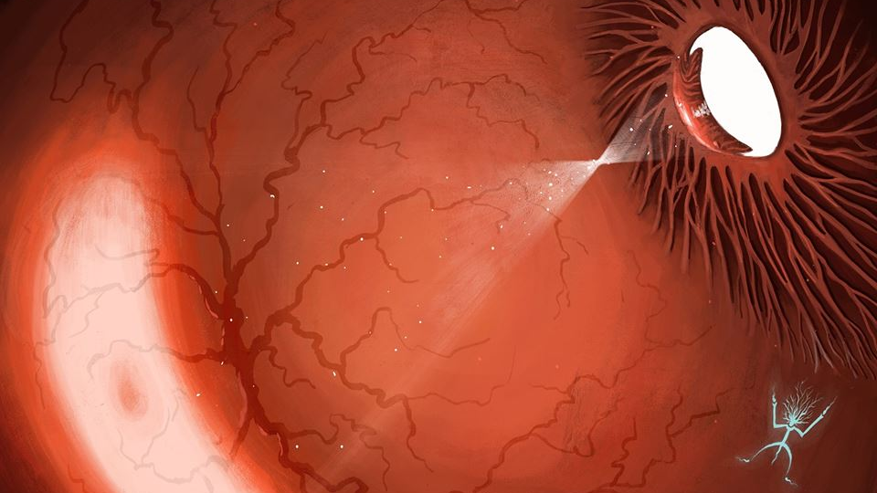


Image Processing Project

Slide 2

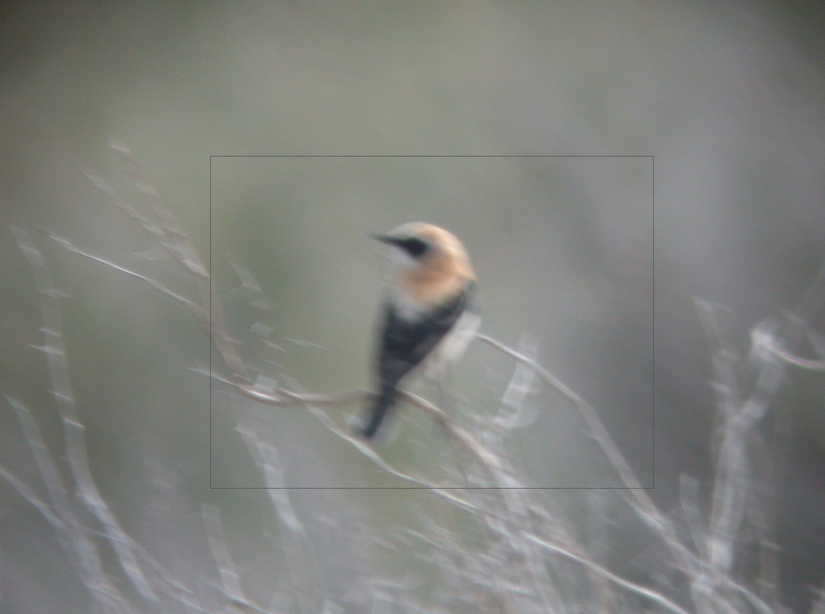
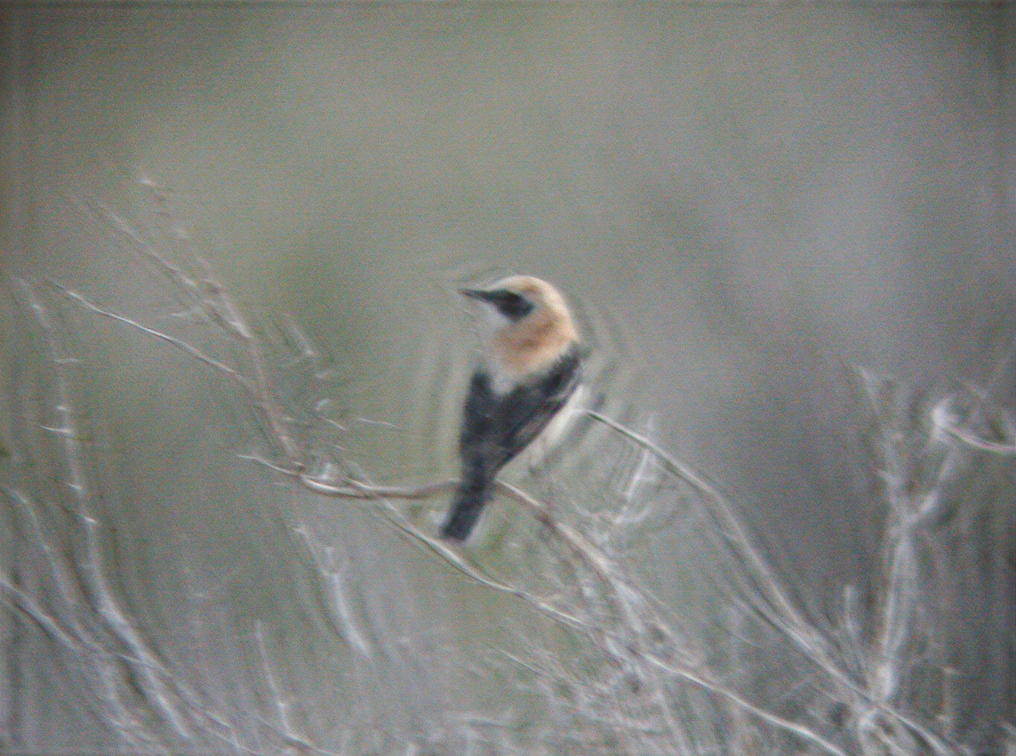
Richardson-Lucy Iterations
Number of iterations to use when unblurring the image using the kernel
If too many iterations, the noise also gets amplified
Standard Image
10 iterations

Slide 3
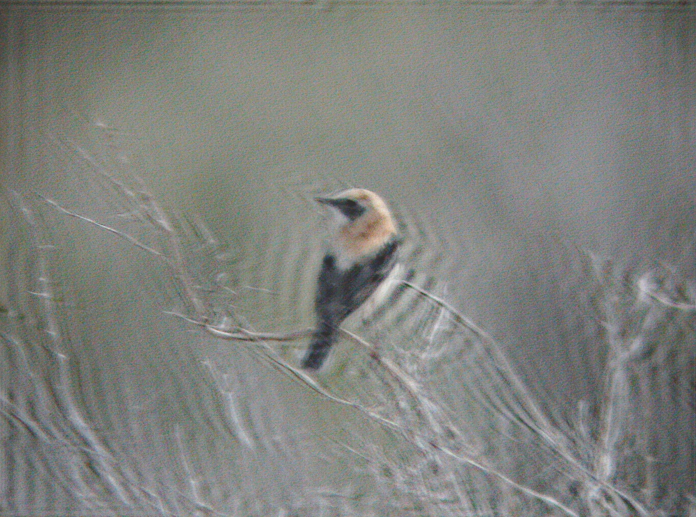
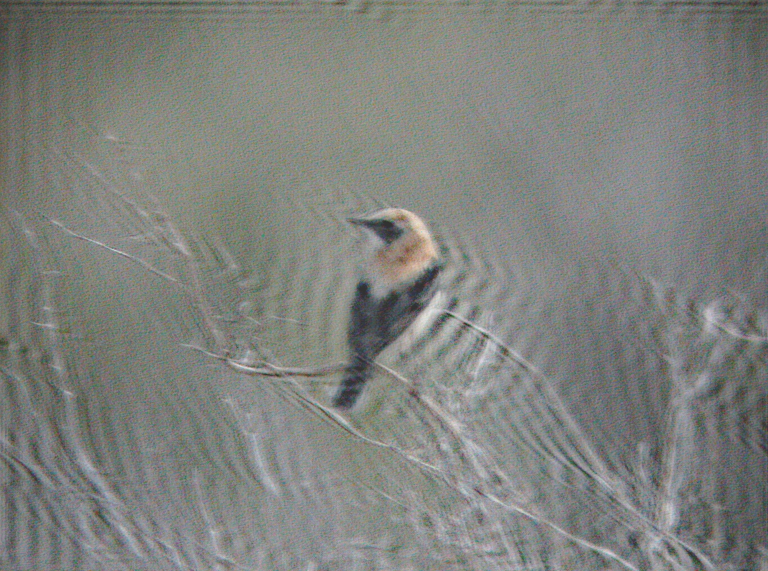
Richardson-Lucy Iterations
Standard Image
20 iterations
30 iterations
The process to achieve each one of the images above took around 15 minutes

Slide 4
Threshold on Kernel intensities
Threshold applied after the inference stage, defined to remove noise from kernel
Dynamic threshold which is the percentage of the maximum value of the kernel
If not desired, set it to a large number (i.e. 100)
If the threshold is too high, it will erode the structure of the kernel

Slide 5
THANK YOU!

